Slide 1

Loan Prediction System
Om Chavan 20104056
Parthavi Khatu 20104108
Sampada Mahadik 20104092
Project Guide
Ms. Geetanjali Kalme

Slide 2
Contents
Introduction
Objectives
Scope
Literature Survey
Proposed System
Project Outcomes
Block Diagram
Use Case/DFD
Technology Stack
Suggestions in Review-1
Result and Discussion
Conclusion and Future Scope
References

Slide 3
1. Introduction
Problem Identified :
    The major problem faced by individual was they generally used to go to bank or any type of finance company to get the eligibility or knowledge about the loans.
    Loan prediction is a very common real-life problem that every finance company faces in their lending operations.
Solution Proposed :
    By using our Loan Prediction System user will get and proper idea about his/her loan eligibility status and information about the loans within few clicks.
    If the loan approval process is automated, it can save a lot of man hours and improve the accuracy and speed of service to the customers.

Slide 4
2. Objectives
To develop user friendly interface for the customer.
To develop an loan eligibility prediction system with less errors and high accuracy percentage.
To develop an system which will give a basic information related to different types of financial loans.
To develop an loan prediction system which can save a lot of man hours and improve the accuracy and speed of service to the customers.
To develop an system which will calculate the simple interest according to the amount entered.

Slide 5
3. Scope
Can be helpful for the customer to understand the loan eligibility status.
Can be useful for the customer to get the accurate prediction of the loan.
Can be useful for the customer to get the basic knowledge regarding the types of financial loans.
Can be useful for the user to calculate the simple interest rate within few clicks.
Can be useful for any individual as it will save a lot of time of the user to predict his/her loan approval.

Slide 6
4. Literature Survey
YEAR | AUTHOR | TITLE | ALGORITHMS | LIMITATIONS
2021 | 1]S. Sreesouthry 2]A. Ayubkhan 3]M. Mohamed 4]Rizwan D. 5]Lokesh K. 6]Prithivi Raj | Loan prediction using Logistic Regression in Machine Learning. | 1.Min-Max normalization. 2.Linear Regression. | Imbalanced dataset was used.
2020 | 1]Veeraballi Nagajyothi , | Loan approval prediction . (ICESC) | 1.KNN. 2.Decision tree . 3.Naive Bayes . | Large number of attributes were prime for consideration.
2020 | 1] T Sunitha 2] M Chandravallika 3] M Ranganayak | Predicting loan status using Logistic Regression and Binary Tree. (ICICNIS) | 1.Logistic Regression(LR). 2.Binary Tree. | No detailed information about dataset is mentioned in the paper i.e. no of instances (cases) used in it.

Slide 7
5. Proposed System
User Friendly and Easy To Use :
    Customer panel allows user to enter the personal details and predict the eligibility of the loan.
    Our loan prediction system is language independent.
Loans information section :
    Customer can get an basic information regarding different types of financial loans.
Simple interest rate calculator :
    Customer can calculate his/her simple interest rate by entering the values within few clicks.
Review section :
    Customer can share their experience/opinion of prediction in the review section.

Slide 8
6. Algorithm used
1. Decision trees.
With a decision tree, you can visualize the map of potential results for a series of decisions. It enables companies to compare possible outcomes and then take a straightforward decision based on parameters.

Slide 9
7. Outcome of Project
Customer can be able to predict their loan eligibility status with less errors and high accuracy.
User can get an proper and basic information regarding different types of loans.
User can be able to calculate the simple interest rate of the loan
As our loan prediction system is language independent any individual can be able to use it easily.
The main outcome of this project is that the user can be able to save his/her precious time by predicting the loan within few clicks.

Slide 10
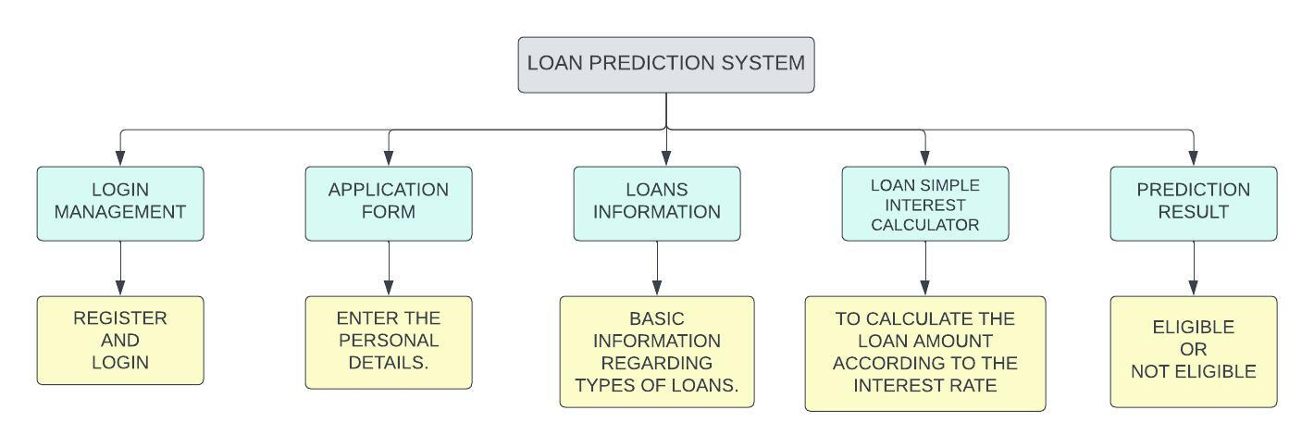
8. Block Diagram

Slide 11
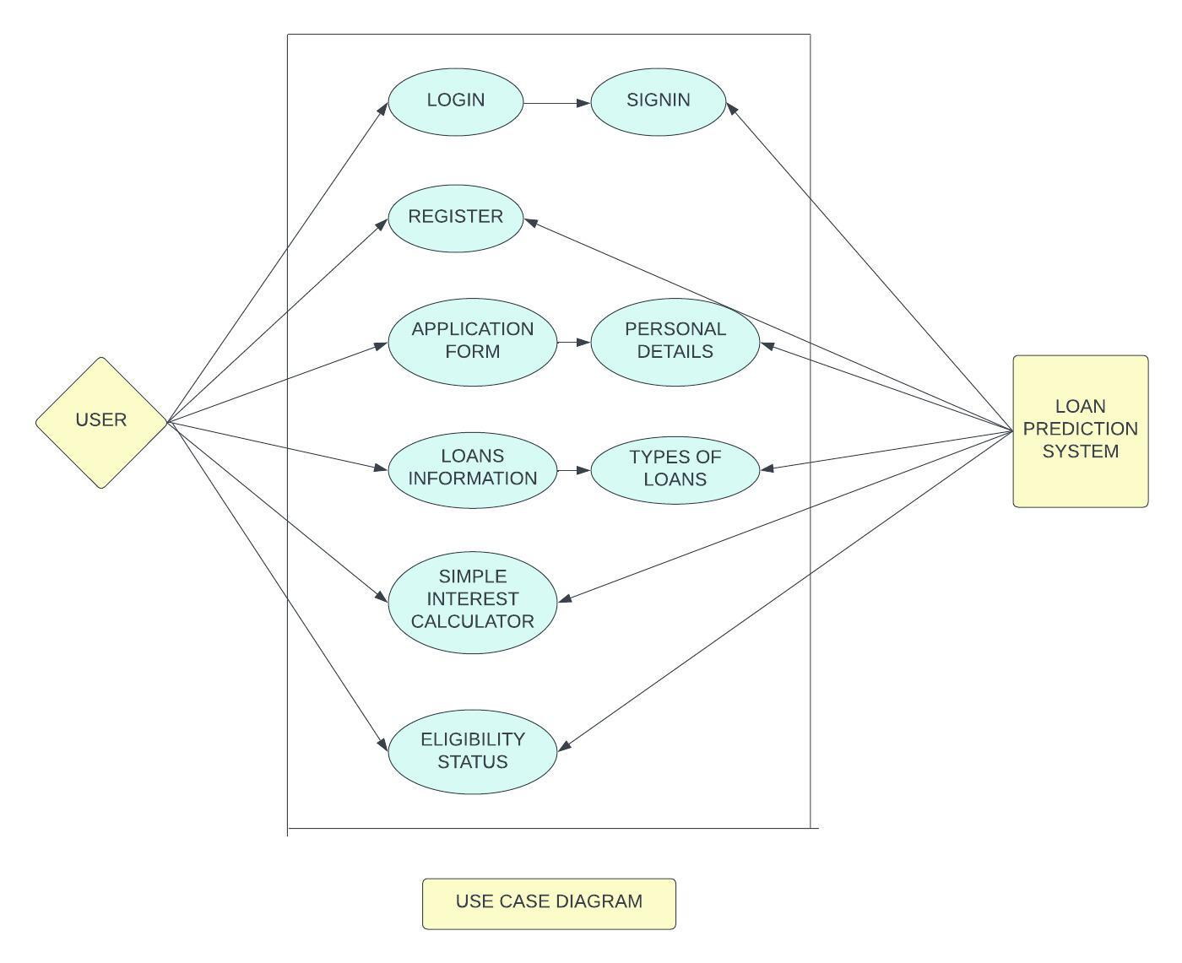
9. Use Case/Data Flow Diagram

Slide 12
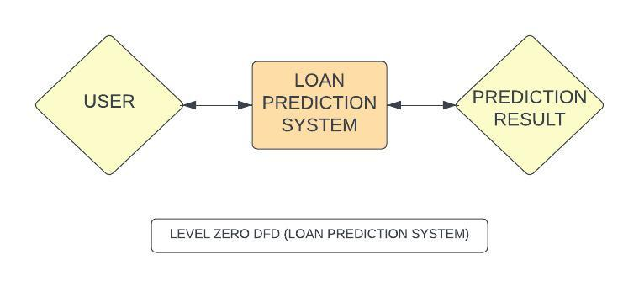
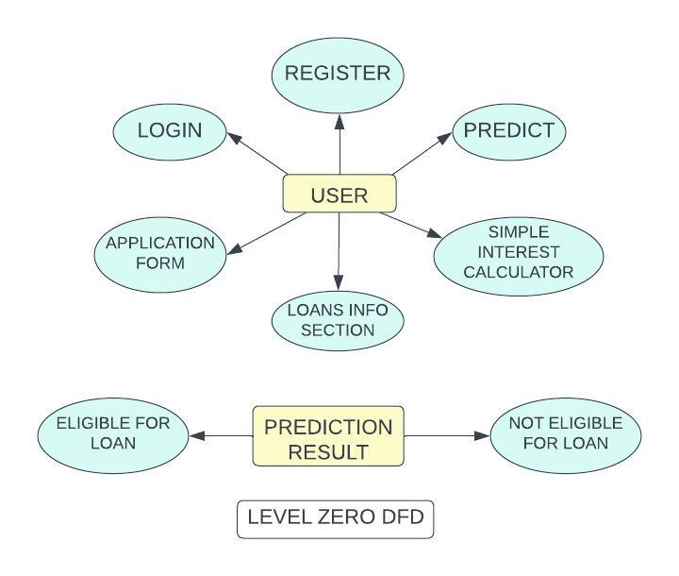

Slide 13
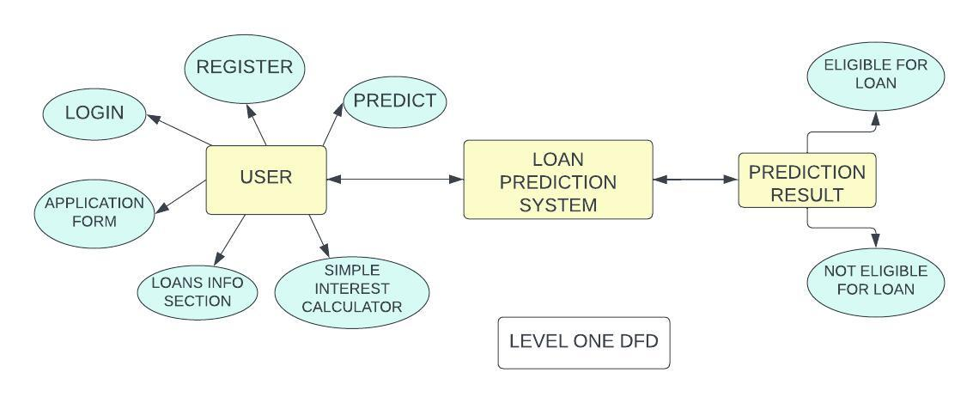

Slide 14
10. Technology Stack
Front-end – Html ,CSS , Java script ,Python (Flask).
Integrated Development Environment (IDE) – VS code.
Platform - Windows 10/11.

Slide 15
Suggestions in Review-1
To add document upload option in Application form.

Slide 16
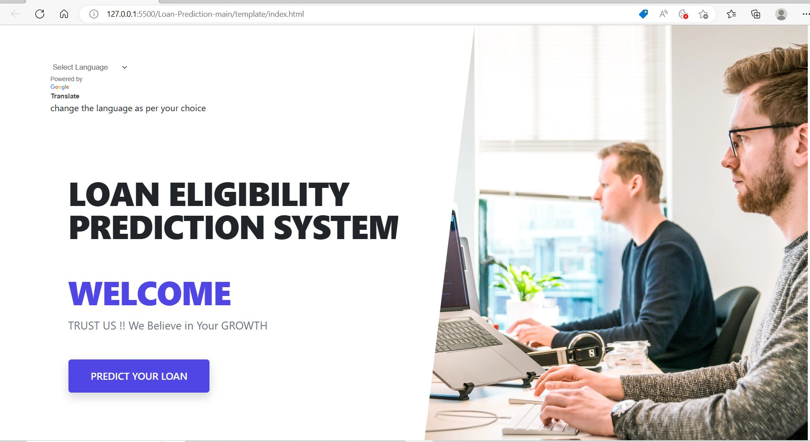
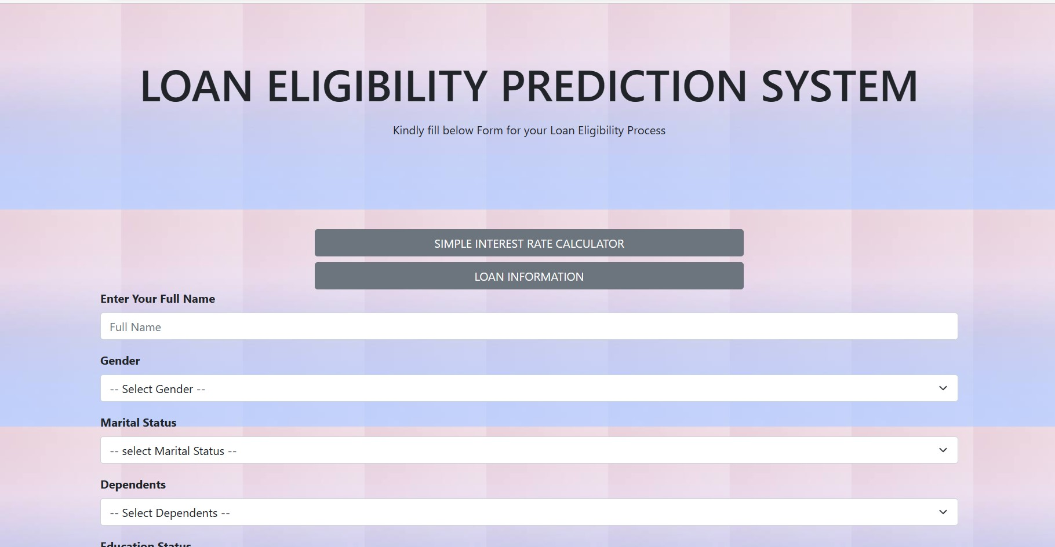
Result and discussion

Slide 17
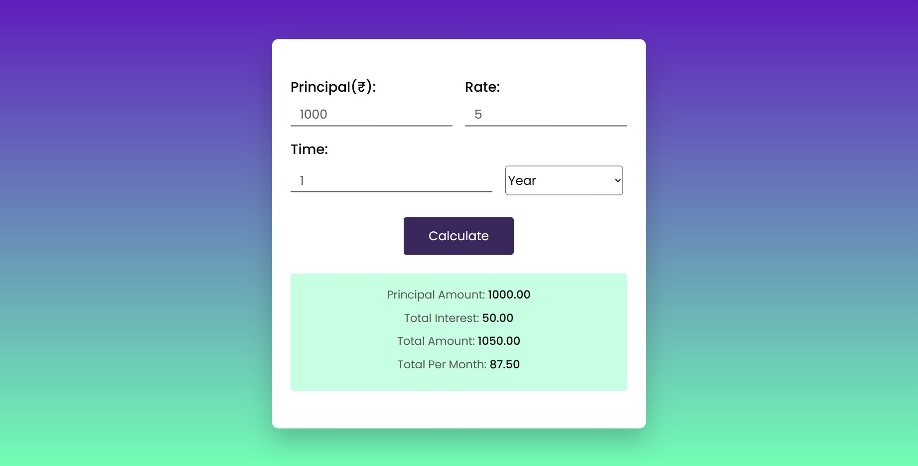
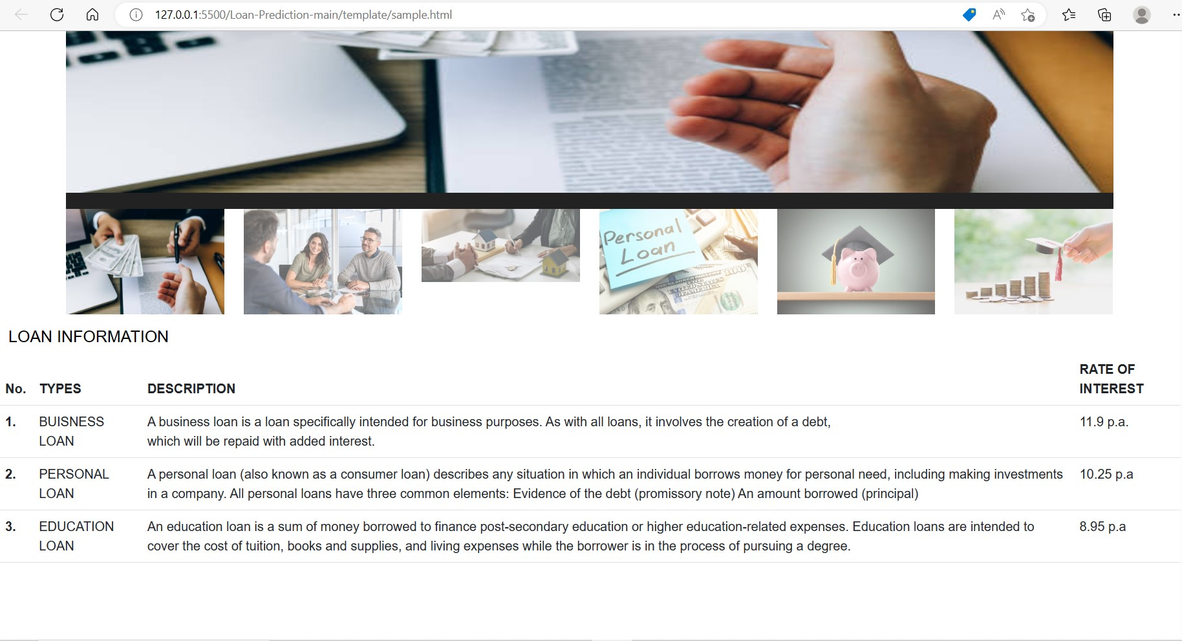
Result and discussion

Slide 18



Slide 19
Conclusion and Future Scope
The loan prediction system project is a valuable tool for financial institutions to evaluate the creditworthiness of potential borrowers. By using machine learning algorithms to analyze various factors such as credit history, employment status, income level, and loan amount, the system can provide accurate predictions on whether a borrower is likely to repay their loan on time or default. The loan prediction system not only helps financial institutions mitigate risks and make informed lending decisions but also provides borrowers with fair and transparent loan evaluation processes.

Slide 20
Moreover, the project can be further enhanced with the incorporation of new features such as real-time data analysis, automated loan processing, and personalized loan recommendations. Overall, the loan prediction system project has the potential to revolutionize the lending industry by improving efficiency, reducing costs, and promoting responsible lending practices.

Slide 21
Reference
S. Sreesouthry, A. Ayubkhan, M. Mohamed Rizwan, D. Lokesh, K. Prithivi Raj (2021). Loan Prediction Using Logistic Regression in Machine Learning. Annals of the Romanian Society for Cell Biology. http://annalsofrscb.ro/index.php/journal/article/view/2818
T Sunitha, M Chandravallika, M Ranganayak (2020), “Predicting loan status using Logistic Regression and Binary Tree (ICICNIS). https://papers.ssrn.com/sol3/papers.cfm?abstract_id=3769854

Slide 22
3. Veeraballi Nagajyothi, “Loan approval prediction using KNN, decision Tree and Naïve Bayes models”(2020), International Journal of Engineering in Computer (IJECS) . Science. https://www.computersciencejournals.com/ijecs/archives/2020.v2.i1.A.30
4. Pidikiti Supriya, MyneediPavani, Nagarapu Saisushma, NamburiVimala Kumari, k Vikash (2019), “Loan Prediction by using Machine Learning Models”, International Journal of Engineering and Techniques. http://www.ijetjournal.org/volume5/issue2/IJET-V5I2P28.pdf

Slide 23
Thank You...!!

